Slide 1
Introduction to Dynamic Routing Protocol
Routing Protocols and Concepts – Chapter 3

Slide 2
Objectives
Describe the role of dynamic routing protocols and place these protocols in the context of modern network design.
Identify several ways to classify routing protocols.
Describe how metrics are used by routing protocols and identify the metric types used by dynamic routing protocols.
Determine the administrative distance of a route and describe its importance in the routing process.
Identify the different elements of the routing table.

Slide 3
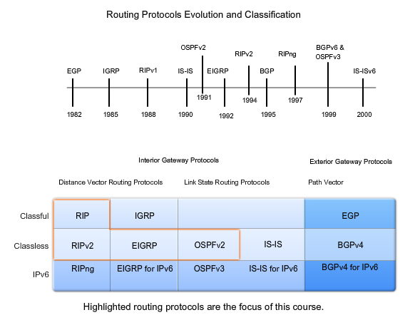
Protocol Evolution

Slide 4
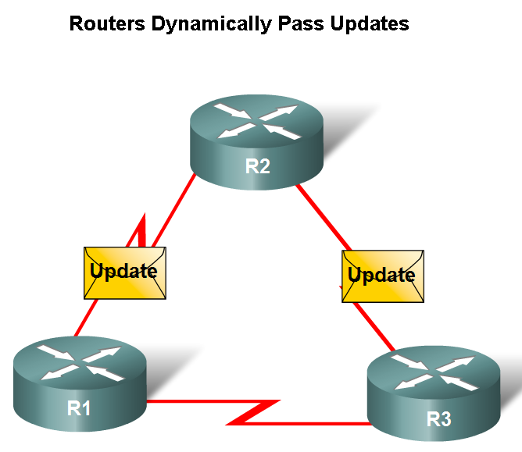
Dynamic Routing Protocols
Function(s) of Dynamic Routing Protocols:
  -Dynamically share information between routers.
  -Automatically update routing table when topology changes.
  -Determine best path to a destination.

Slide 5
Dynamic Routing Overview
Compared to static routing, dynamic routing protocols require less administrative overhead.
However, the expense of using dynamic routing protocols is dedicating part of a router's resources for protocol operation including CPU time and network link bandwidth.
Despite the benefits of dynamic routing, static routing still has its place. There are times when static routing is more appropriate and other times when dynamic routing is the better choice.
More often than not, you will find a combination of both types of routing in any network that has a moderate level of complexity

Slide 6
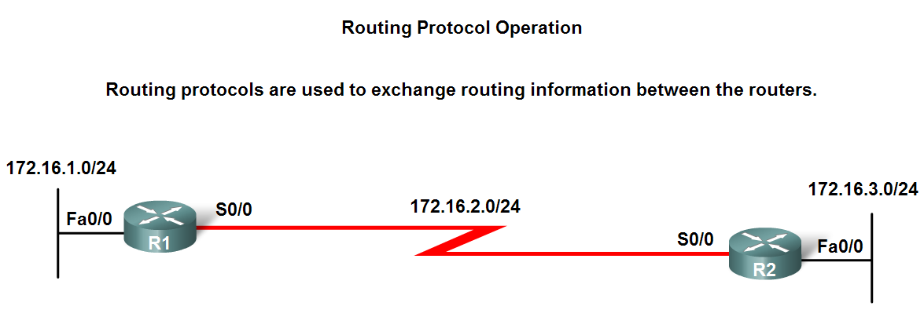
Dynamic Routing Protocols
The purpose of a dynamic routing protocol is to:
  -Discover remote networks
  -Maintaining up-to-date routing information
  -Choosing the best path to destination networks
  -Ability to find a new best path if the current path is no longer available

Slide 7
Dynamic Routing Protocols
Components of a routing protocol
Data structures - Some routing protocols use tables and/or databases for its operations. This information is kept in RAM.
Algorithm - An algorithm is a finite list of steps used in accomplishing a task. Routing protocols use algorithms for facilitating routing information and for best path determination.
Routing protocol messages - Routing protocols use various types of messages to discover neighbouring routers, exchange routing information, and other tasks to learn and maintain accurate information about the network.

Slide 8
Dynamic Routing Protocols
Advantages of static routing
  -It can backup multiple interfaces/networks on a router
  -Easy to configure
  -No extra resources are needed
  -More secure
Disadvantages of static routing
  -Network changes require manual reconfiguration
  -Does not scale well in large topologies

Slide 9
Dynamic Routing Operation
The operations of a dynamic routing protocol vary depending upon the type of routing protocol and the routing protocol itself. In general, the operations of a dynamic routing protocol can be described as follows:
The router sends and receives routing messages on its interfaces.
The router shares routing messages and routing information with other routers that are using the same routing protocol.
Routers exchange routing information to learn about remote networks.
When a router detects a topology change the routing protocol can advertise this change to other routers.

Slide 10
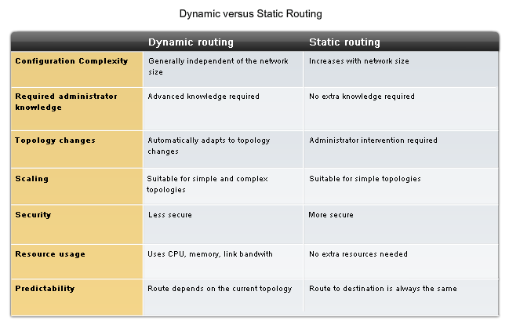
Dynamic vs. Static

Slide 11
Dynamic Routing Advantages + Disadvantages
Dynamic routing advantages:
Administrator has less work maintaining the configuration when adding or deleting networks.
Protocols automatically react to the topology changes.
Configuration is less error-prone.
More scalable, growing the network usually does not present a problem.
Dynamic routing disadvantages:
Router resources are used (CPU cycles, memory and link bandwidth).
More administrator knowledge is required for configuration, verification, and troubleshooting.

Slide 12
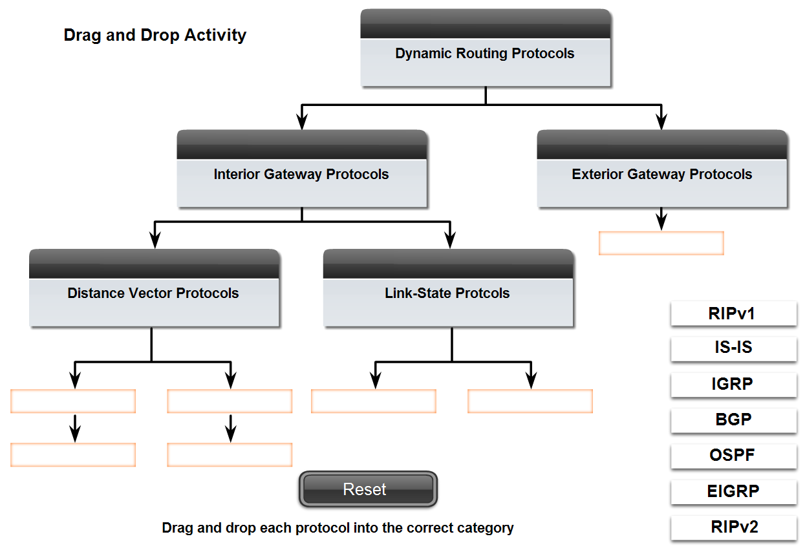
Classifying Routing Protocols
Dynamic routing protocols are grouped according to characteristics. Examples include:
  -RIP
  -IGRP
  -EIGRP
  -OSPF
  -IS-IS
  -BGP
Autonomous System is a group of routers under the control of a single authority.

Slide 13
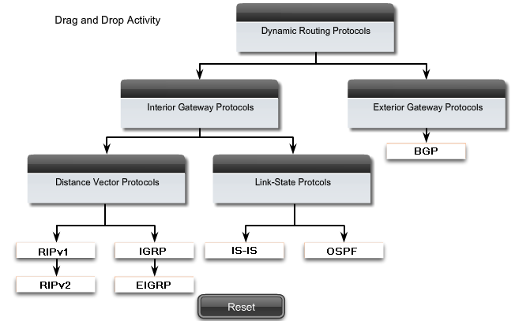
Activity

Slide 14
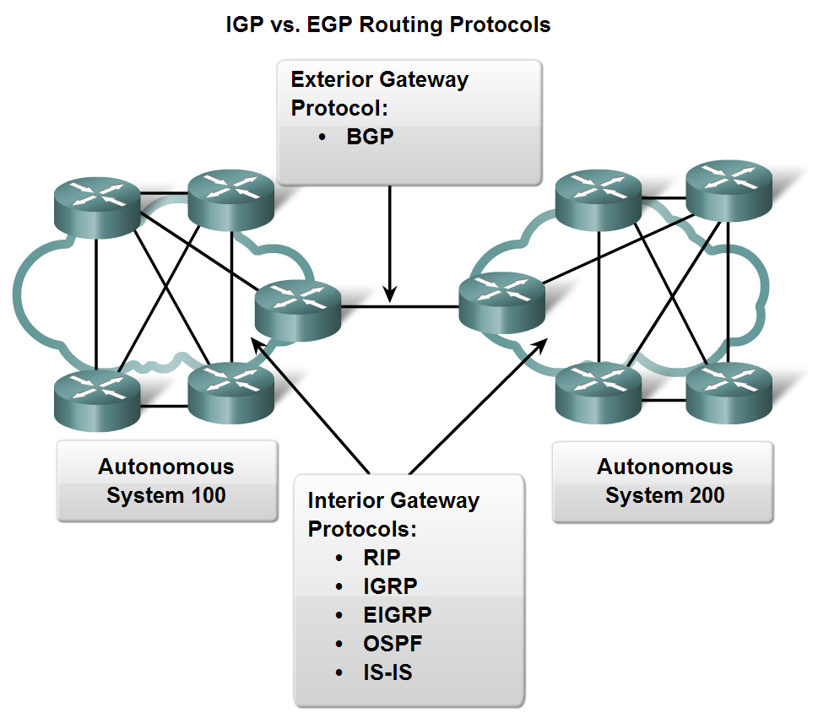
Classifying Routing Protocols
Types of routing protocols:
  -Interior Gateway Protocols (IGP)
  -Exterior Gateway Protocols (EGP)

Slide 15
Classifying Routing Protocols
Interior Gateway Routing Protocols (IGP)
  -Used for routing inside an autonomous system & used to route within the individual networks themselves.
  For example, CENIC operates an autonomous system comprised of California schools, colleges and universities. CENIC uses an IGP to route within its autonomous system in order to interconnect all of these institutions.
  Each of the educational institutions also uses an IGP of their own choosing to route within its own individual network.
  The IGP used by each entity provides best path determination within its own routing domains, just as the IGP used by CENIC provides best path routes within the autonomous system itself.
  - Examples: RIP, EIGRP, OSPF
Exterior Routing Protocols (EGP)
  -Used for routing between autonomous systems. BGP is the only currently-viable EGP and is the routing protocol used by the Internet.
  -Example: BGPv4

Slide 16
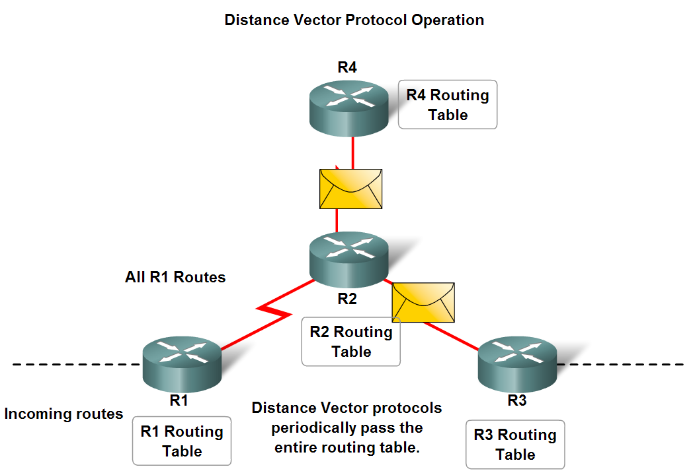
Classifying Routing Protocols
IGP: Comparison of Distance Vector & Link State Routing Protocols
  Distance vector
  routes are advertised as vectors
  of distance & direction.
  incomplete view of network
  topology.
  Generally, periodic
  updates.
  Link state
  complete view of network
  topology is created.
  updates are not
  periodic.

Slide 17
Distance Vector
Distance vector protocols work best in situations where:
The network is simple and flat and does not require a special hierarchical design.
The administrators do not have enough knowledge to configure and troubleshoot link-state protocols.
Specific types of networks, such as hub-and-spoke networks, are being implemented.
Worst-case convergence times in a network are not a concern.
Link-state protocols work best in situations where:
The network design is hierarchical, usually occurring in large networks.
The administrators have a good knowledge of the implemented link-state routing protocol.
Fast convergence of the network is crucial.

Slide 18
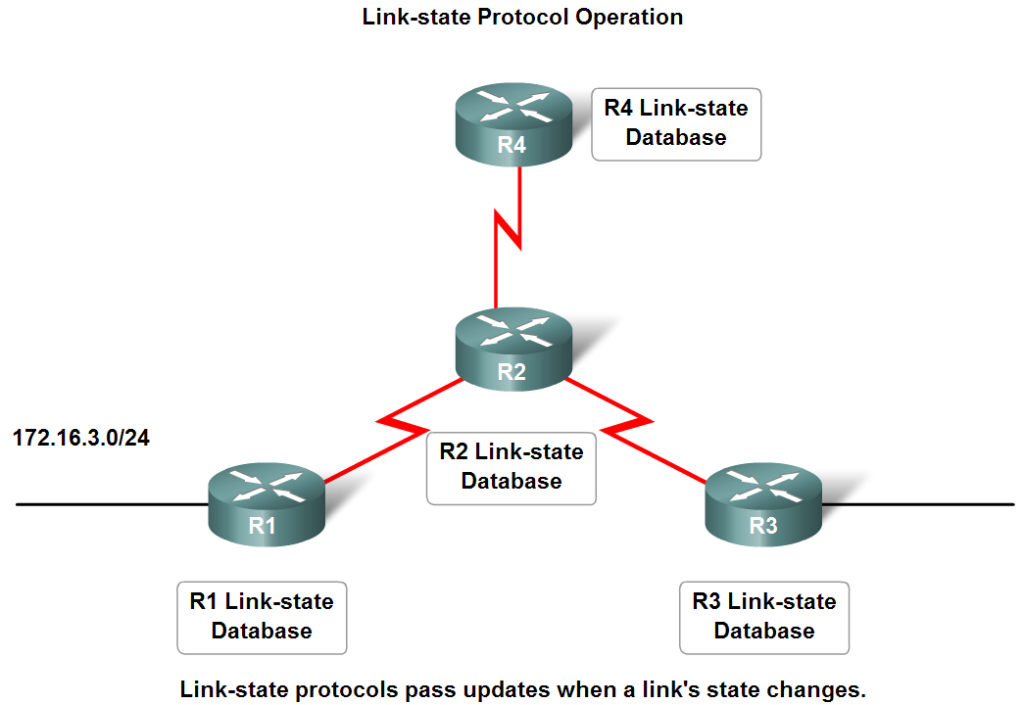
Classifying Routing Protocols

Slide 19
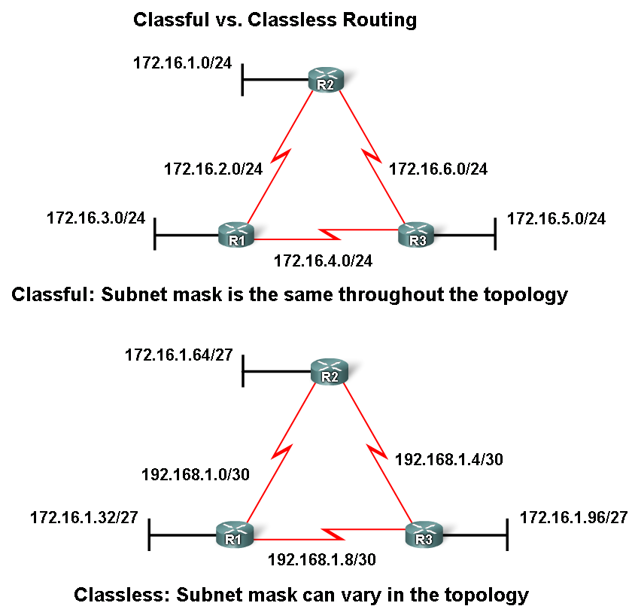
Classifying Routing Protocols
Classful routing protocols
  Do NOT send subnet mask in routing updates
  Classful routing protocols include RIPv1 and IGRP.
Classless routing protocols
  Do send subnet mask in
  routing updates.
  Classless routing protocols are RIPv2, EIGRP, OSPF, IS-IS, BGP.

Slide 20
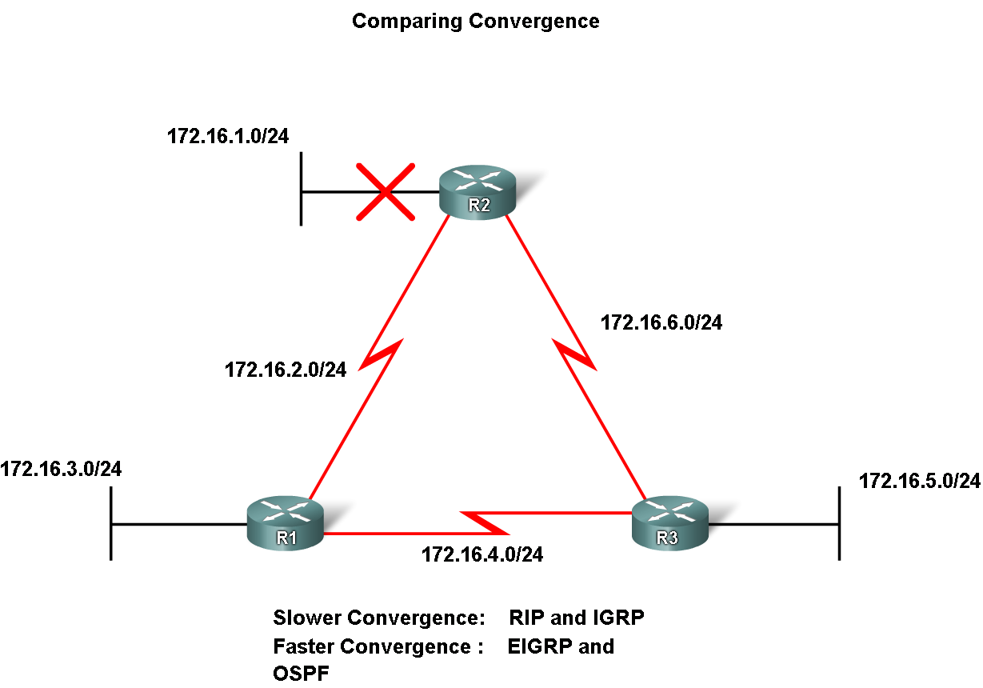
Classifying Routing Protocols
Convergence is defined as when all routers’ routing tables are at a state of consistency

Slide 21
Convergence
Convergence is when all routers' routing tables are at a state of consistency. The network has converged when all routers have complete and accurate information about the network.
Convergence time is the time it takes routers to share information, calculate best paths, and update their routing tables.
A network is not completely operable until the network has converged; therefore, most networks require short convergence times. Convergence is both collaborative and independent.
The routers share information with each other but must independently calculate the impacts of the topology change on their own routes. Because they develop an agreement with the new topology independently, they are said to converge on this consensus.
Convergence properties include the speed of propagation of routing information and the calculation of optimal paths. Routing protocols can be rated based on the speed to convergence; the faster the convergence, the better the routing protocol.
Generally, RIP and IGRP are slow to converge, whereas EIGRP and OSPF are faster to converge.

Slide 22
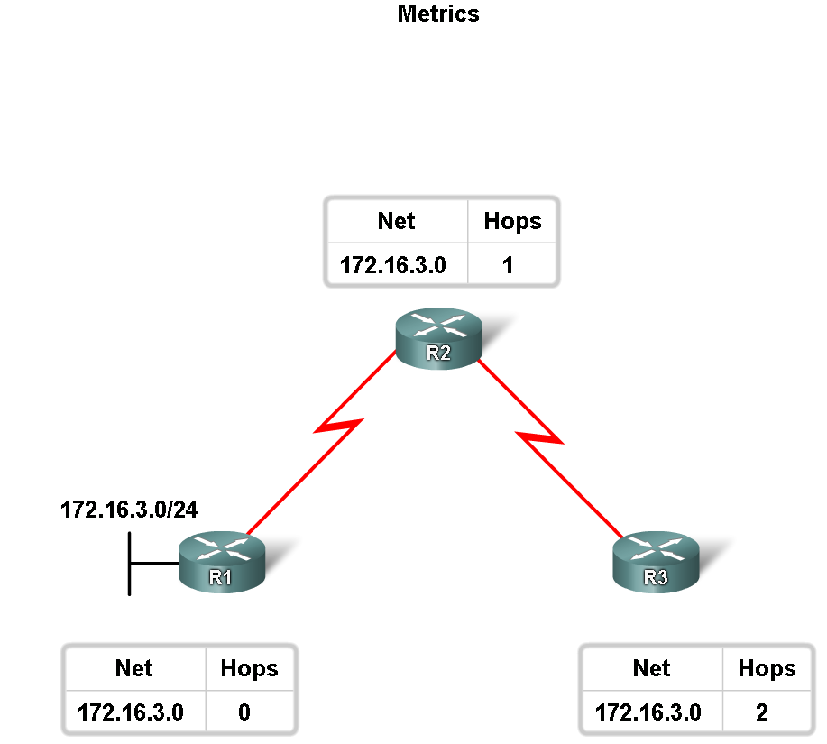
Routing Protocols Metrics
Metric
  A value used by a routing protocol to determine which routes are better than others.
  The metric is used to determine which path is most preferable when there are multiple paths to the same remote network.

Slide 23
Metrics
Metrics used in IP routing protocols include:
Hop count - A simple metric that counts the number of routers a packet must traverse
Bandwidth - Influences path selection by preferring the path with the highest bandwidth
Load - Considers the traffic utilization of a certain link
Delay - Considers the time a packet takes to traverse a path
Reliability - Assesses the probability of a link failure, calculated from the interface error count or previous link failures
Cost - A value determined either by the IOS or by the network administrator to indicate preference for a route. Cost can represent a metric, a combination of metrics or a policy.

Slide 24
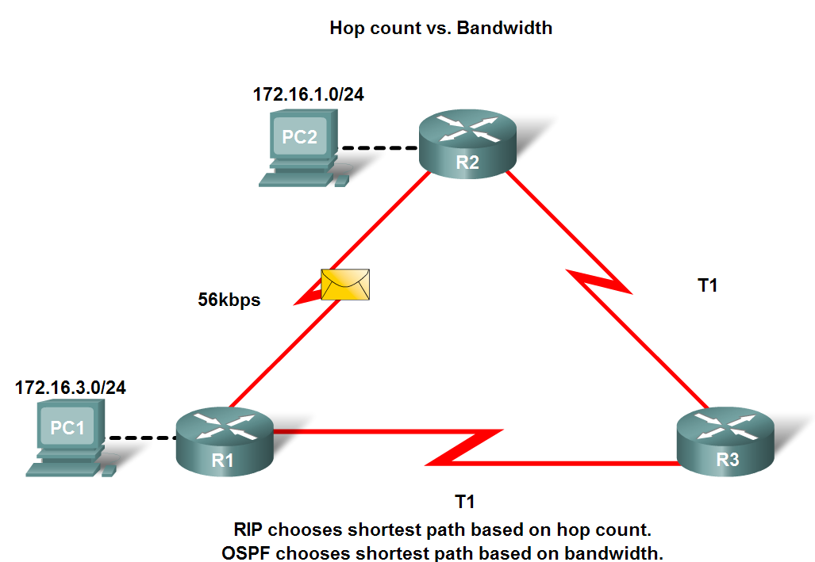
Routing Protocols Metrics
Metrics used in IP routing protocols
  -Bandwidth
  -Cost
  -Delay
  -Hop count
  -Load
  -Reliability

Slide 25

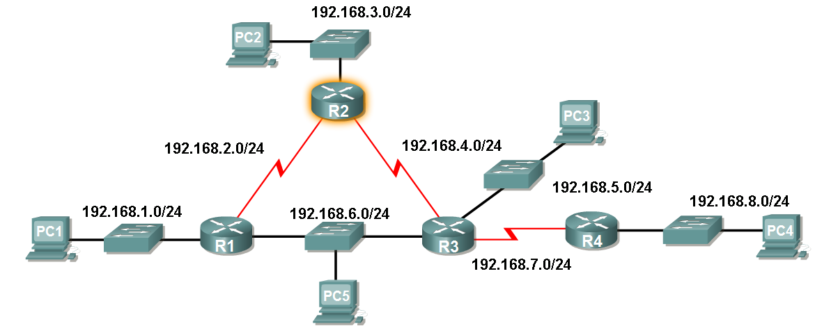
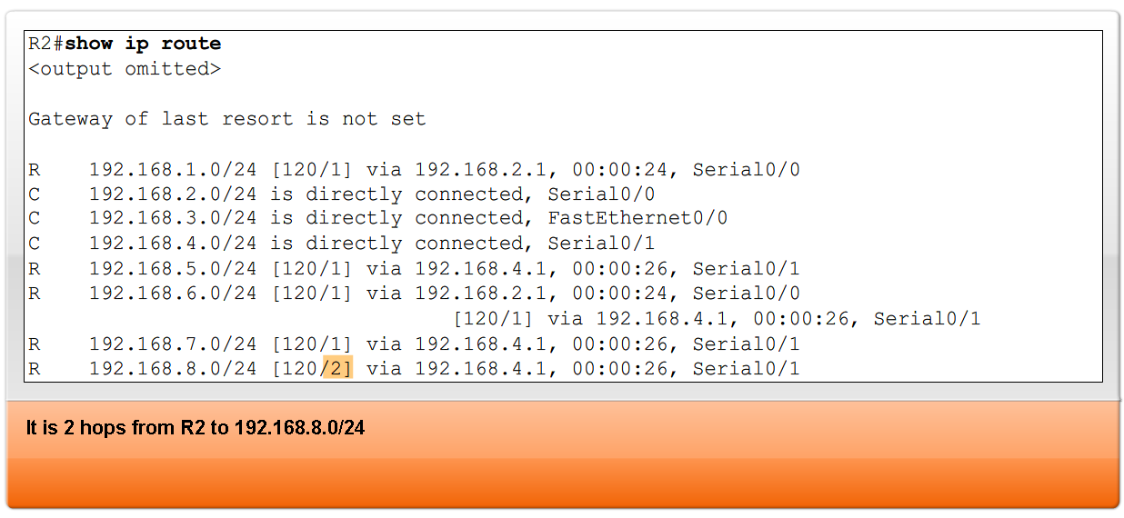
Routing Protocols Metrics
The Metric Field in the Routing Table
Metric used for each routing protocol
  -RIP - hop count
  -IGRP & EIGRP - Bandwidth (used by default), Delay (used by default), Load, Reliability
  -IS-IS & OSPF – Cost, Bandwidth (Cisco’s implementation)

Slide 26
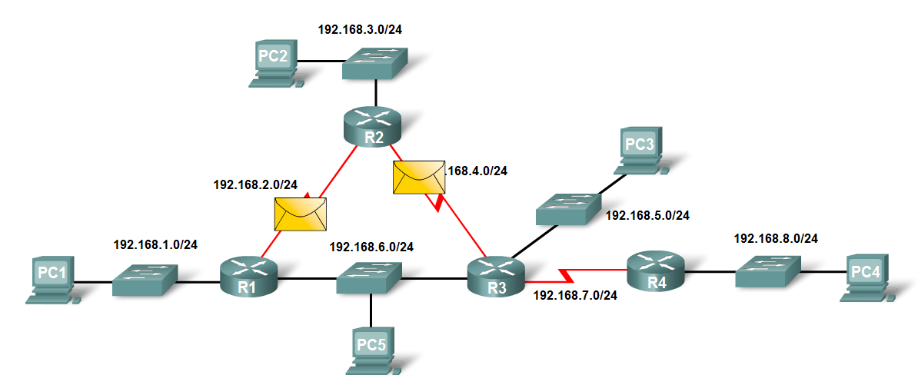
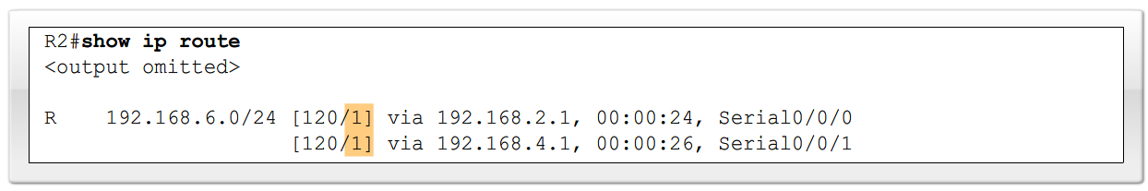
Routing Protocols Metrics
Load balancing
  This is the ability of a router to distribute packets among multiple same cost paths

Slide 27
Load Balancing
We have discussed that individual routing protocols use metrics to determine the best route to reach remote networks.
But what happens when two or more routes to the same destination have identical metric values?
How will the router decide which path to use for packet forwarding?
In this case, the router does not choose only one route. Instead, the router "load balances" between these equal cost paths. The packets are forwarded using all equal-cost paths.
To see whether load balancing is in effect, check the routing table. Load balancing is in effect if two or more routes are associated with the same destination.

Slide 28
Example
R2 load balances traffic to PC5 over two equal cost paths.
The show ip route command reveals that the destination network 192.168.6.0 is available through 192.168.2.1 (Serial 0/0/0) and 192.168.4.1 (Serial 0/0/1).
R 192.168.6.0/24 [120/1] via 192.168.2.1, 00:00:24,
Serial0/0/0 [120/1] via 192.168.4.1, 00:00:26, Serial0/0/1

Slide 29
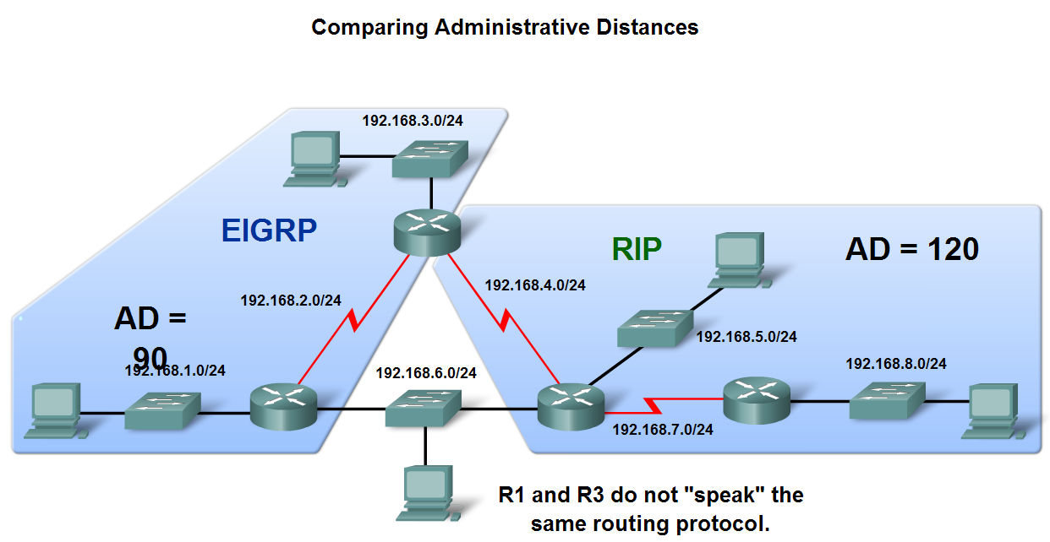
Administrative Distance of a Route
Purpose of a metric
  It’s a calculated value used to determine the best path to a destination
Purpose of Administrative Distance
  It’s a numeric value that specifies the preference of a particular route

Slide 30
Administrative Distance
Administrative distance (AD) defines the preference of a routing source.
Each routing source - including specific routing protocols, static routes, and even directly connected networks - is prioritized in order of most- to least-preferable using an administrative distance value.
Cisco routers use the AD feature to select the best path when it learns about the same destination network from two or more different routing sources.
Administrative distance is an integer value from 0 to 255.
The lower the value the more preferred the route source.
An administrative distance of 0 is the most preferred.
Only a directly connected network has an administrative distance of 0, which cannot be changed.
An administrative distance of 255 means the router will not believe the source of that route and it will not be installed in the routing table.

Slide 31
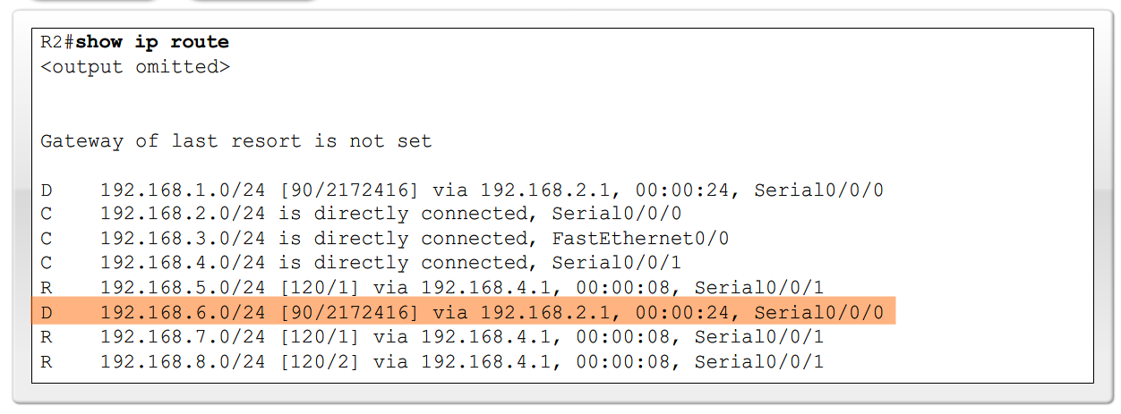

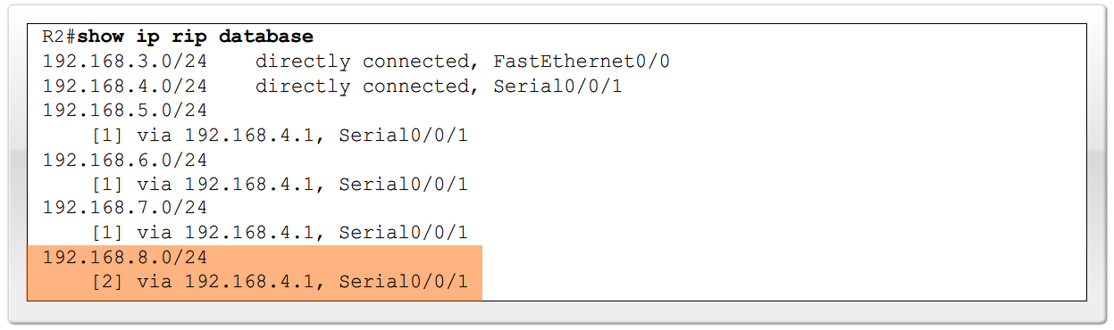
Administrative Distance of a Route
Identifying the Administrative Distance (AD) in a routing table
  It is the first number in the brackets in the routing table

Slide 32
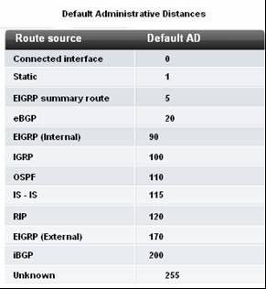
Administrative Distance of a Route
Dynamic Routing Protocols

Slide 33
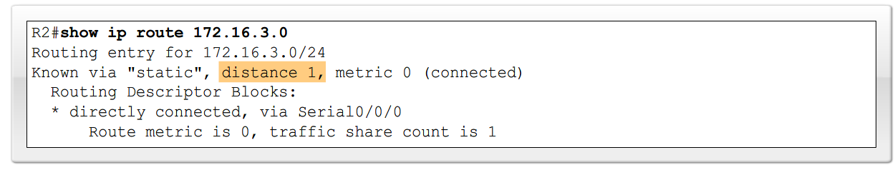
Administrative Distance of a Route
Directly connected routes
  Have a default AD of 0
Static Routes
  Administrative distance of a static route has a default value of 1

Slide 34
Misconception
The static route to 172.16.3.0 is listed as directly connected.
However, there is no information on what the AD value is. It is a common misconception to assume that the AD value of this route must be 0 because it states "directly connected."
However, that is a false assumption. The default AD of any static route, including those configured with an exit interface is 1.
Remember, only a directly connected network can have an AD of 0.
This can be verified by extending the show ip route command with the [route] option. Specifying the [route] reveals detailed information about the route, including its distance, or AD value.

Slide 35
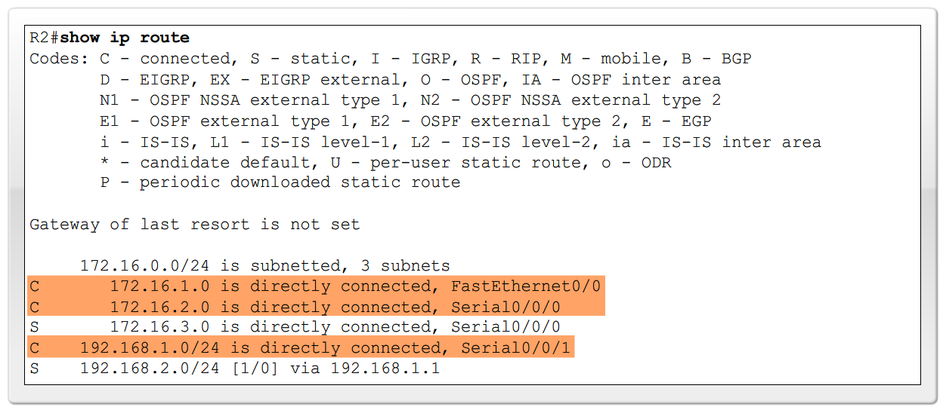
Administrative Distance of a Route
Directly connected routes
  -Immediately appear in the routing table as soon as the interface is configured

Slide 36
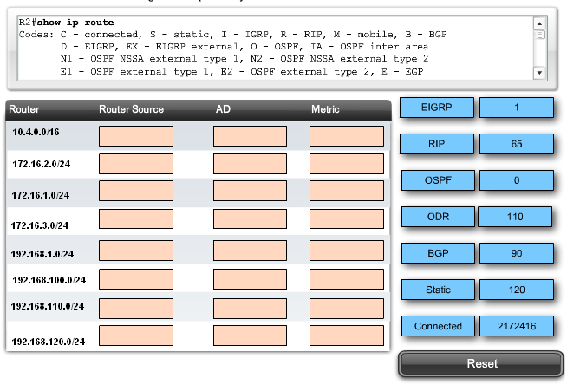
Exercise

Slide 37


Routing Table Entries

Slide 38
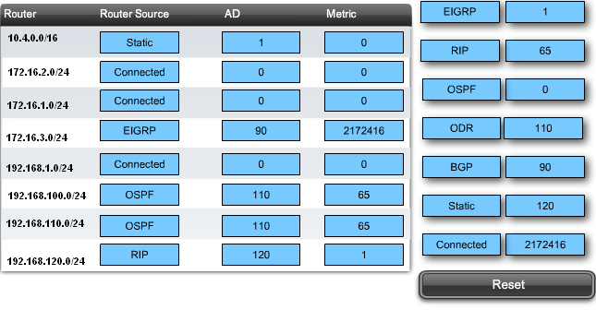
Answers

Slide 39
Summary
Dynamic routing protocols fulfill the following functions
  -Dynamically share information between routers
  -Automatically update routing table when topology changes
  -Determine best path to a destination
Routing protocols are grouped as either
  -Interior gateway protocols (IGP)Or
  -Exterior gateway protocols(EGP)
Types of IGPs include
  -Classless routing protocols - these protocols include subnet mask in routing updates
  -Classful routing protocols - these protocols do not include subnet mask in routing update

Slide 40
Summary
Metrics are used by dynamic routing protocols to calculate the best path to a destination.
Administrative distance is an integer value that is used to indicate a router’s “trustworthiness”
Components of a routing table include:
  -Route source
  -Administrative distance
  -Metric

